Slide 1

OpenFlow：Enabling Innovation in Campus Network
Speaker:李嘉凱
Adviser:柯開維 教授

Slide 2
Outline
Introduction
The Need For Programmable Network
The OpenFlow Switch
Using OpenFlow
Conclusion
Reference

Slide 3
Introduction
It is based on an Ethernet switch, with an internal ﬂow-table, and a standardized interface to add and remove ﬂow entries.
OpenFlow could serve as a useful campus component in proposed large-scale testbeds like GENI.

Slide 4
The Need For Programmable Network
Today, there is almost no practical way to experiment with new network protocols in sufficiently realistic setting to gain the confidence needed for their widespread deployment.
These programmable networks call for programmable switches and routers that can process packets for multiple isolated experimental networks simultaneously.
Virtualized programmable networks could lower the barrier to entry for new ideas, increasing the rate of innovation in the network infrastructure.

Slide 5
OpenFlow is a specification that is an initial attempt to meet the goal
  high-performance and low-cost implementations.
  Capable of supporting a broad range of research.
  Assured to isolate experimental traffic from production traffic.
  Consistent with vendors’ need for closed platforms.

Slide 6
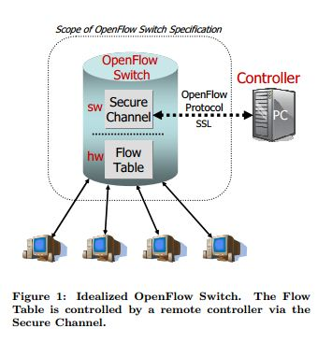
The OpenFlow Switch
Consist of at least three parts：
  A Flow Table
  A Secure Channel
  The OpenFlow Protocol

Slide 7
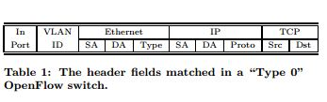
  Each ﬂow-entry has a simple action associated with it：
    Forward this ﬂow’s packets to a given port (or ports).
    Encapsulate and forward this ﬂow’s packets to a controller.
    Drop this ﬂow’s packets.
    Forward this ﬂow’s packets through the switch’s normal processing pipeline.(OpenFlow-enable switch)
  An entry in the Flow-Table has three ﬁelds:
    A packet header that deﬁnes the ﬂow.
    The action, which deﬁnes how the packets should be processed.
    Statistics which keep track of the number of packets and bytes for
    each ﬂow, and the time since the last packet matched the ﬂow
Notes:
In the ﬁrst generation “Type 0” switches, the ﬂow header is a 10-tuple shown in Table 1.
A TCP ﬂow could be speciﬁed by all ten ﬁelds, whereas an IP ﬂow might not include the transport ports in its deﬁnition. Each header ﬁeld can be a wildcard to allow for aggregation of ﬂows, such as ﬂows
in which only the VLAN ID is deﬁned would apply to all traﬃc on a particular VLAN.
The detailed requirements of an OpenFlow Switch are deﬁned by the OpenFlow Switch Speciﬁcation [6].

Slide 8
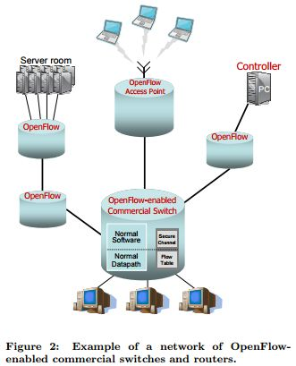
Controllers：
A controller adds and removes ﬂow-entries from the Flow Table on behalf
of experiments.

Slide 9
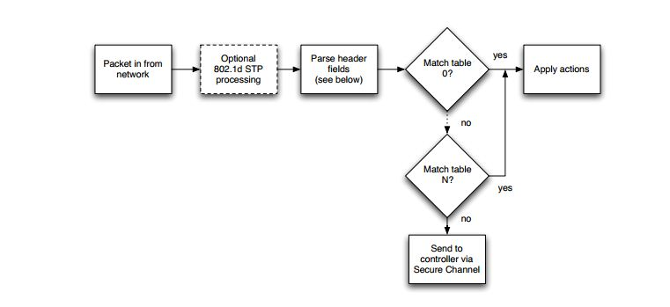

Slide 10
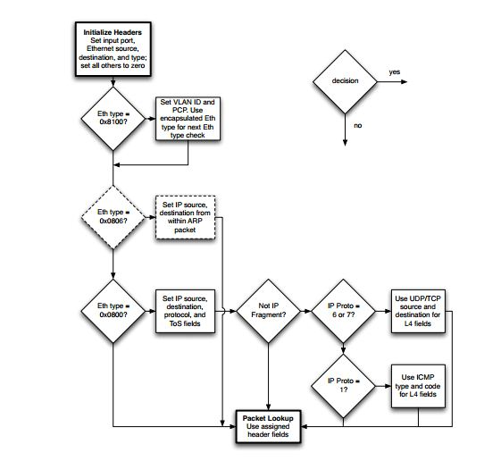

Slide 11
Using OpenFlow
If someone want to try their protocol in a network of OpenFlow Switches, without changing any end-host software.
The protocol will run in a controller; each time
a new application flow starts that protocol
picks a route through a series of OpenFlow
Switch,and adds a flow entry in each switch
along the path.

Slide 12
Using OpenFlow(2)
If someone is testing a new protocol in a network used by lots of other people. It will have two additional properties：
  Packets belonging to users other than the researcher should be routed using a standard and tested routing protocol running in the switch or router from a “name-brand” vendor.
  the researcher should only be able to add flow entries for his traffic, or for any traffic his network administrator has allowed her to control.

Slide 13
Using Openflow(3)
Example 1 ：Network Management and access Control
an OpenFlow Switch can be thought of as a generalization of Ethane’s datapath switch. The controller checks a new flow against a set of rules , and associates packets with their senders by managing all the bindings between names and addresses.
Example 2：VLANs
The simplest approach is to statically declare a set of flows which specify the ports accessible by traffic on a given VLAN ID.
Example 3: Mobile wireless VOIP
In the experiment VOIP clients establish a new connection over the OpenFlow-enabled network. A controller is implemented to track the location of clients, re-routing connections as users move through the network (by reprogramming the Flow Tables ), allowing seamless handoff from one access point to another.

Slide 14
Using OpenFlow(4)
Example 4: A non-IP network
OpenFlow doesn’t require packets to be of any one format — so long as the Flow Table is able to match on the packet header. This would allow experiments using new naming, addressing and routing schemes.
Example 5: Processing packets rather than flows
To force all of a flow’s packets to pass through a controller.
To route them to a programmable switch that does packet processing

Slide 15
Conclusion
We believe that OpenFlow is a pragmatic compromise that allows researchers to run experiments on heterogeneous switches and routers in a uniform way, without the need for vendors to expose the internal workings of their products, or researchers to write vendor-specific control software.

Slide 16
Reference
N. McKeown, T. Anderson, H. Balakrishnan, G. Parulkar, L. Peterson, J. Rexford, S. Shenker, and J. Turner, “OpenFlow: Enabling Innovation in Campus Networks,” ACM SIGCOMM Computer Communication Review, vol. 38, no. 2, p. 6, 2008.
“OpenFlow Switch Specification, Version 1.0.0,” December 2009.

